Slide 1
Topics
1.Router 2.Routing

Slide 2
Router
Router is a device which makes connection possible between two or more different networks present at same or different geographical locations.
It works on 3rd layer of OSI Model(i.e on network layer)
It does two basic things:.
Select the best path from the routing table.
Forward the packet on that path.

Slide 3
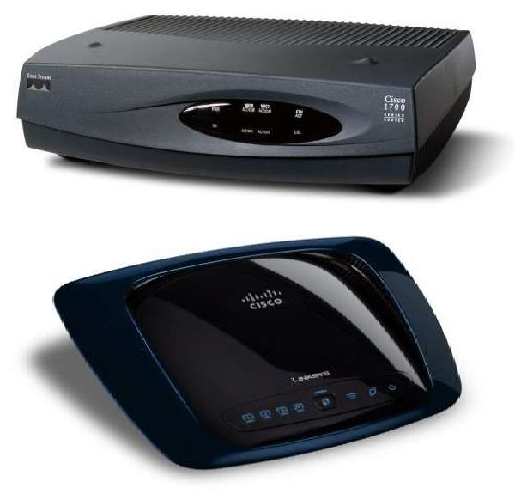
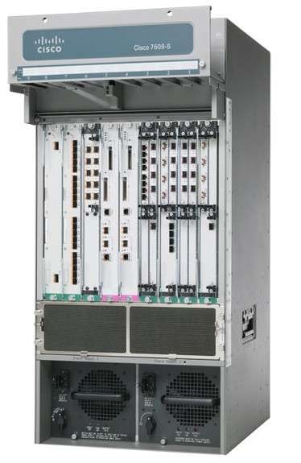

Slide 4
Vendors of Router
Many companies are manufacturing routers
Cisco
Nortel
Multicom
Juniper
Dlink
3com

Slide 5
Cisco is the leading manufacturer of routers and switches.It manufactures 70% of routers and switches of the market.

Slide 6
1. Access level/layer
3 level hierarchy Cisco router
Distribution level/layer
Core level/layer

Slide 7
Access Layer Routers
Routers which are used by the small organizations and are also known as Desktop routers or company layer routers.
Access layer routers are of low speed, low processing power, low RAM and lower no of ports and are also low price.

Slide 8
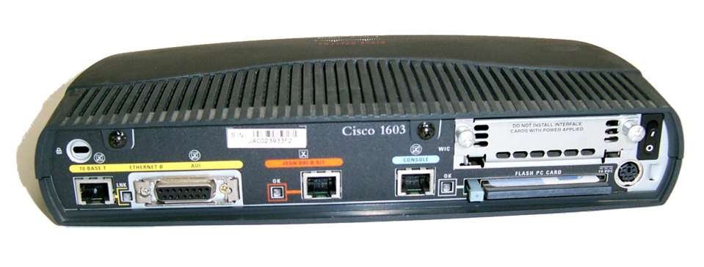
Router Series
800,1000,1600,1700,2500

Slide 9
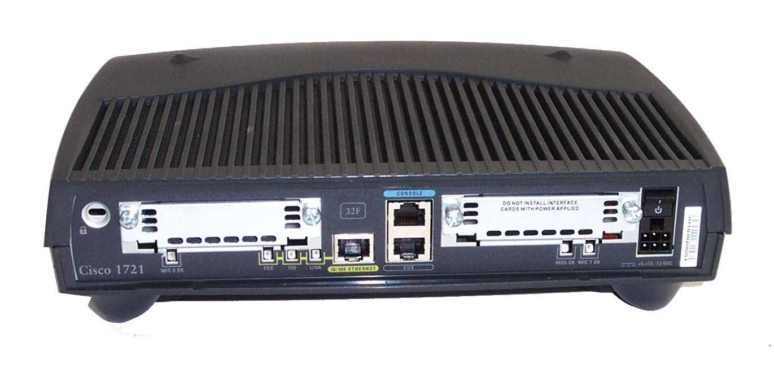
1700 Series Router

Slide 10
Distribution Layer Routers
Routers which are used by ISP’s and are also known as ISP layer routers.
Distribution layer routers are batter in speed, processing and RAM than access layer routers.
These routers are costly than access layer routers

Slide 11
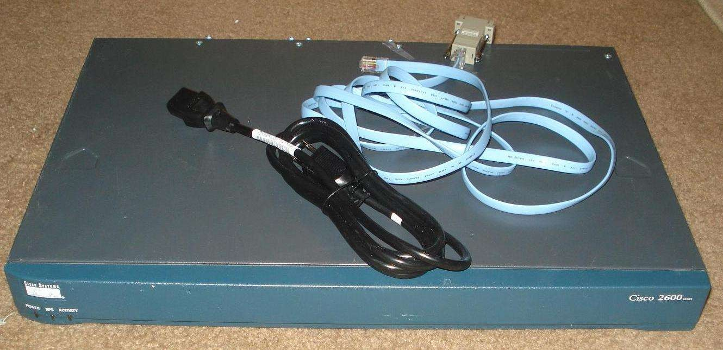
Router Series
2600,3200,3600,3700

Slide 12
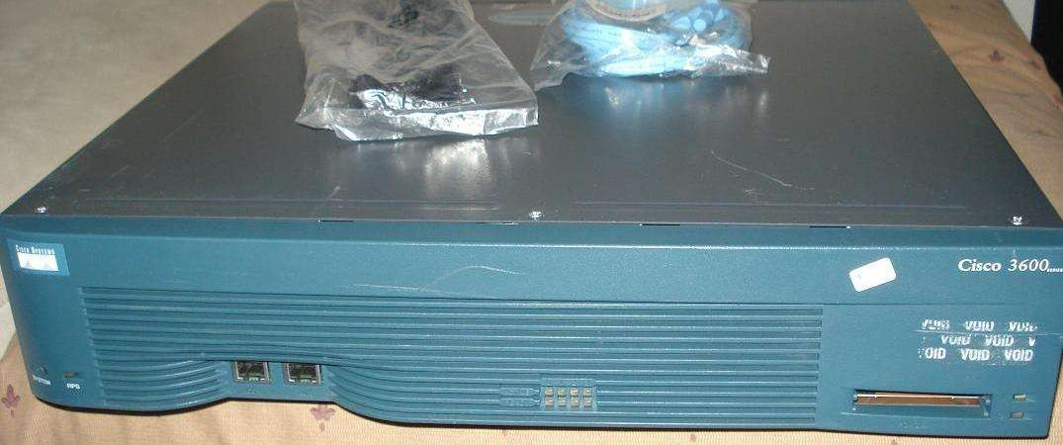
3600 Series Router
Front side

Slide 13
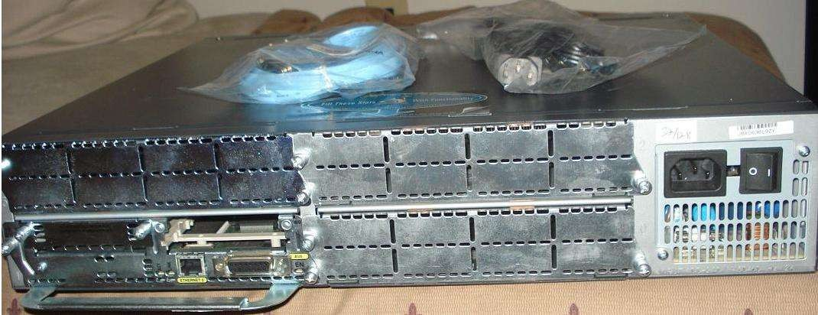
3600 Series Router
Back Side

Slide 14
Core Layer Router
Routers that are used by the Global ISP’s and are also known as backbone routers.
Core layer routers are best routers than all and are costly routers.
Router series
6400,7200,7300,7400,7500,7600,10000,
12000

Slide 15
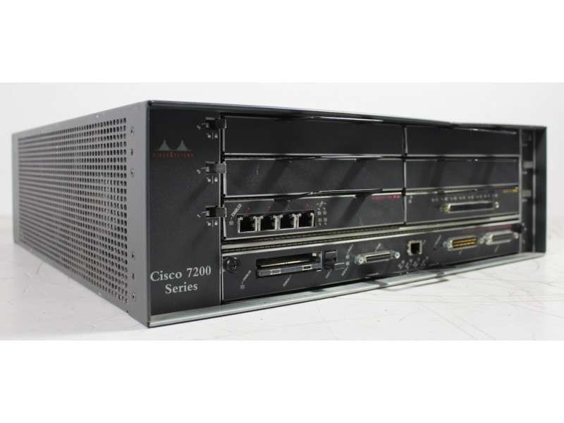
7200 Series Router

Slide 16
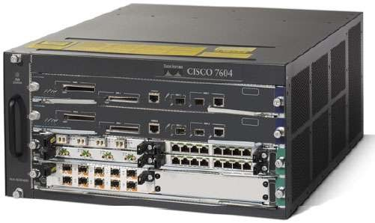
7600 Series Router

Slide 17
Special Series of Routers
Integrated Service Routers/ISR
They just not do routing, can also do security and voice implementation.
800,1800,2800,3800 etc.

Slide 18
Router Classification
Routers are classified in two classes.
Fixed Routers
Modular Routers

Slide 19
Fixed Routers
Fixed routers are non upgradable, can not add or remove the Ethernet or serial ports.
Does not have any slot.
In fixed routers the ports are integrated on the mother board.(Fixed on mother board).
Access routers are fixed routers.

Slide 20
Modular Routers
Modular Routers are upgradable, can add or remove the interfaces as per our requirement.
Number of slots available depends on the series of the router.
Can add LAN and WAN cards.
Router series greater than 2600 are modular routers.

Slide 21
Ports on Router
There are three types of ports on the router.
LAN ports
WAN ports
Administrative Ports

Slide 22
LAN Ports
The ports where local area network is connected with the router are called LAN ports.
Ethernet ports, fast Ethernet ports, Gig Ethernet ports, 10gbps are LAN ports.
Ethernet 10Mbps
Fast Ethernet 100Mbps
Gig Ethernet 1000Mbps
All Ports are of RJ45 connectors

Slide 23
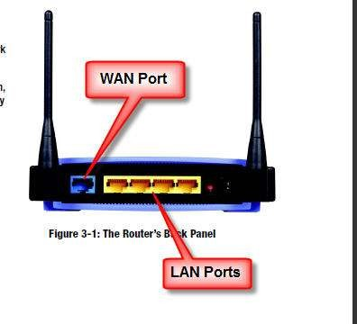
LAN Ports

Slide 24
WAN Ports
Ports that are used for WAN connection/router to router connection are called WAN ports.
WAN ports are serial interfaces(S0,S1,S0/0,S0/1,S0/0/0 etc).
Serial ports are of two category
26pins
60pins

Slide 25
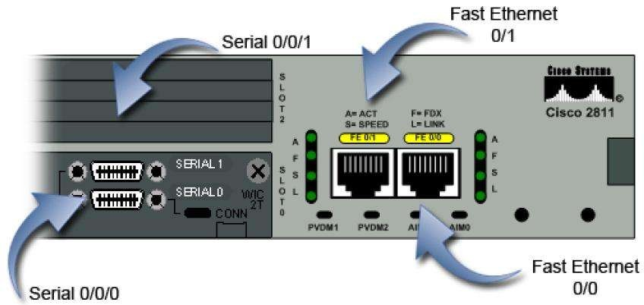
WAN Ports

Slide 26
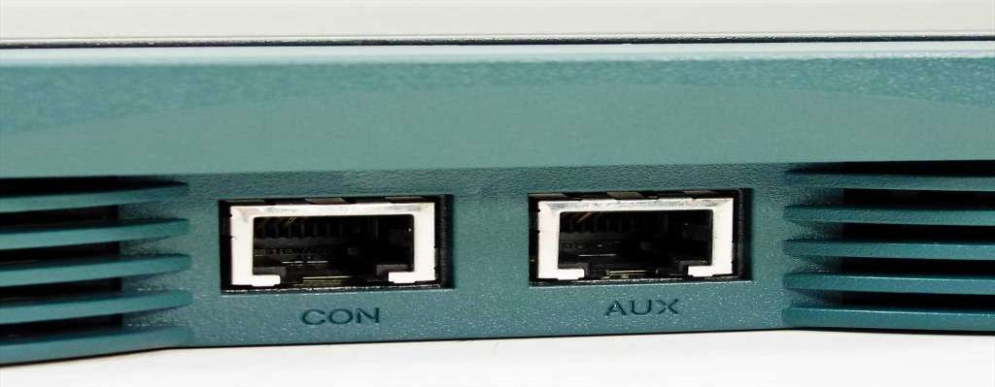
Administrative Ports
Console RJ45-Local administrative
AuxiliaryRJ45-Remote administrative

Slide 27
Console Ports
Console ports are known as Local ports
They are generally used for initial confi- guration, password recovery and local administration of the router.
One side of the console port/cable is RJ45 and other is 9pin com port.

Slide 28
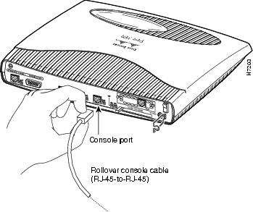
Console Ports
Console ports not carry the traffic like LAN and WAN ports/interfaces, it just carry the commands.

Slide 29
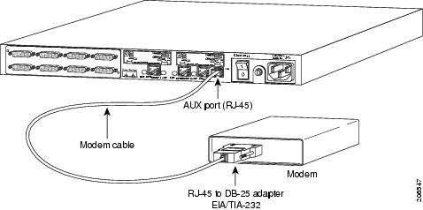
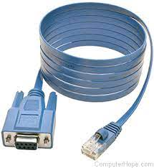
Auxiliary Ports
Auxiliary ports are known as remote administrative ports.
They are RJ45 ports.
A console or a rollover cable is to be used.
RJ45 to DB-25

Slide 30
Internal components of router
ROM(Read Only Memory)
POST(Power on self Test)
Mini-IOS
RAM(Random Access Memory)
Flash Memory
NVRAM(Non-Volatile RAM)

Slide 31
ROM
ROM is a chip integrated on the mother board which contains a bootstrap program which tells how to load the IOS.
Used to start and maintain the router. Holds the POST and Bootstrap program, as well as the mini-IOS.

Slide 32
POST
Stored in the microcode of the ROM.
Micro code is used to check the basic functionality of the router hardware and determines which interfaces are present.

Slide 33
IOS
Internetwork Operating System/IOS.
Operating system inside the router is called IOS.
Different vendors have there own IOS like Cisco IOS, Juniper IOS.
IOS are platform depended e.g Cisco IOS work only with Cisco routers.

Slide 34
RAM
Hold the temporary configurations, ARP cache, routing tables and are also the software and data structures that allow the router to function.
The IOS is loaded in to the RAM from the flash at the time of booting.

Slide 35
Flash Memory
Stores the IOS by default.
Flash memory is not erased when the router is reloaded.

Slide 36
NVRAM
Hold the router and switch configuration
NVRAM is not erased when the router or switch is reloaded/switched off.
The configuration register is stored in the non-volatile memory.
Configuration means passwords, IP addresses and routing table.

Slide 37
Modes of the Router
Here are different modes of the router
Setup Mode
User Mode
Privileged Mode
Global Configuration Mode
Interface Mode

Slide 38
Setup Mode
The router enters in to the setup mode if the NVRAM is empty.
Continue with configuration dialog[yes/no] Answer with ‘Yes’ or ‘No’.
User Mode
Only some basic monitoring
Limited show commands ping, trace,
Router>

Slide 39
Privileged Mode
Monitoring and some troubleshooting.
All show commands, ping trace, copy and erase
Router#
Global Configuration Mode
To make any change that affect the router like hostname, routing configuration.
Router(config)#

Slide 40
Global Configuration Mode
Configurations done on the specific interface.
Router(config-if)#
Rommon Mode
Reverting Password

Slide 41
Basic Commands
Setup Mode
Continue with configuration dialog?[Yes/No]
Answer ‘Yes’ or ‘No’.
User Mode
Router>
Router>enable

Slide 42
Privileged Mode
Router#Show running-config
Router#Show start-config
Router#Show flash
Router#Show version
Router#Show ip interface brief

Slide 43
Global Configuration Mode
Router#Configure Terminal
Router(config)#Hostname R-1
R-1(config)#Show IP route
R-1(config)enable password<password>
R-1(config)enable secret <password>

Slide 44
Interface Mode
Router(config)# interface FastEthernet0/0
Router(config-if)#ip address <ip address>
<Subnet Mask>
Rouetr(config)#interface Serial 0/0
Router(config-if)ip address <ip address>
<Subnet Mask>

Slide 45
Routing
Forwarding the packets from one network to the other network choosing the best path from the routing table.
Routing makes possible for two or more networks to communicate with each other
Routing table only consist of only the best routes for each destination

Slide 46
Types of routing
Static routing
Default routing
Dynamic routing

Slide 47
Static Routing
It is configured manually by the administrator.
Mandatory need for the destination network ID
Used for small organizations
In static routing the administrator decide the best path
Administrator should know that what is the destination ID and how many routes to reach that destination

Slide 48
Advantages
There is no overhead on the router CPU.
There is no bandwidth usage between the routers
It adds security because the administrator can choose to allow routing access to the certain networks only

Slide 49
Note
In static routing router don’t need any update of the route because the route is pre-defined by the administrator

Slide 50
Disadvantages
Used for small network(its not feasible in large networks)
Each and every network have to manually configured.
Any change in the network has to be update in all routers.

Slide 51
Rules to assign the IP address to the router
All the LAN and WAN should be in the different networks(or should not repeat the same network).
Router Ethernet IP address and the LAN IP address should be in the same network.

Slide 52
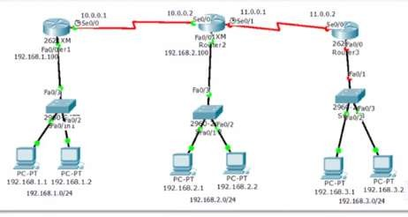
3.Both the interfaces of routers facing each other should be in the same network.
4.All the interfaces of routers should be in the different network.

Slide 53
Configuring the Static Routing
Router(config)#ip route <Destination Network ID> <Destination Subnet Mask><Next Hop IP address>.

Slide 54
Thanks
☺

